Slide 1

TRANSITION
REPORT
2014
tr.ebrd.com
Innovation
in Transition
Produced by the Office of the Chief Economist, EBRD.
© European Bank for Reconstruction and Development

Slide 2
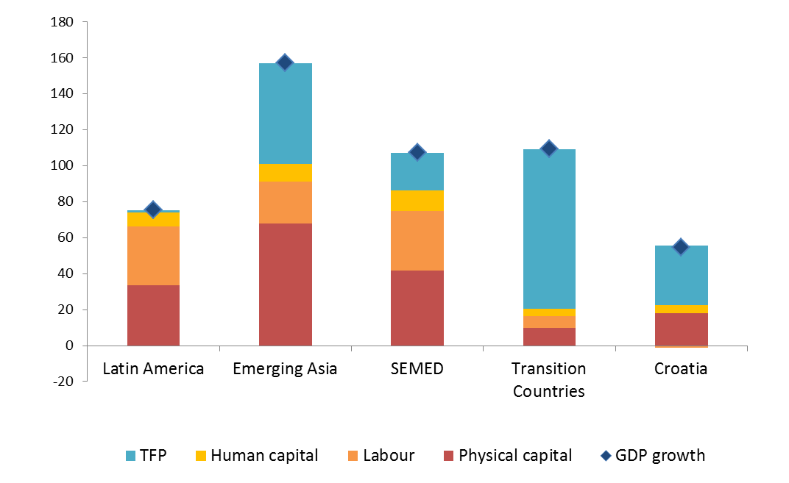
Productivity catch-up in transition region largely complete – how to achieve further productivity gains?
Growth 1993-2010
Growth 1993-2010
Source: EBRD Transition Report 2013, Penn World Tables 8.0.

Slide 3

INNOVATION: Adopt, Adapt, Advance
Innovation goes well beyond R&D in high-tech sectors
Products and production processes new to the firm
Firms need to Adopt, Adapt and Advance towards technological frontier
Innovation = improving productivity within firms

Slide 4
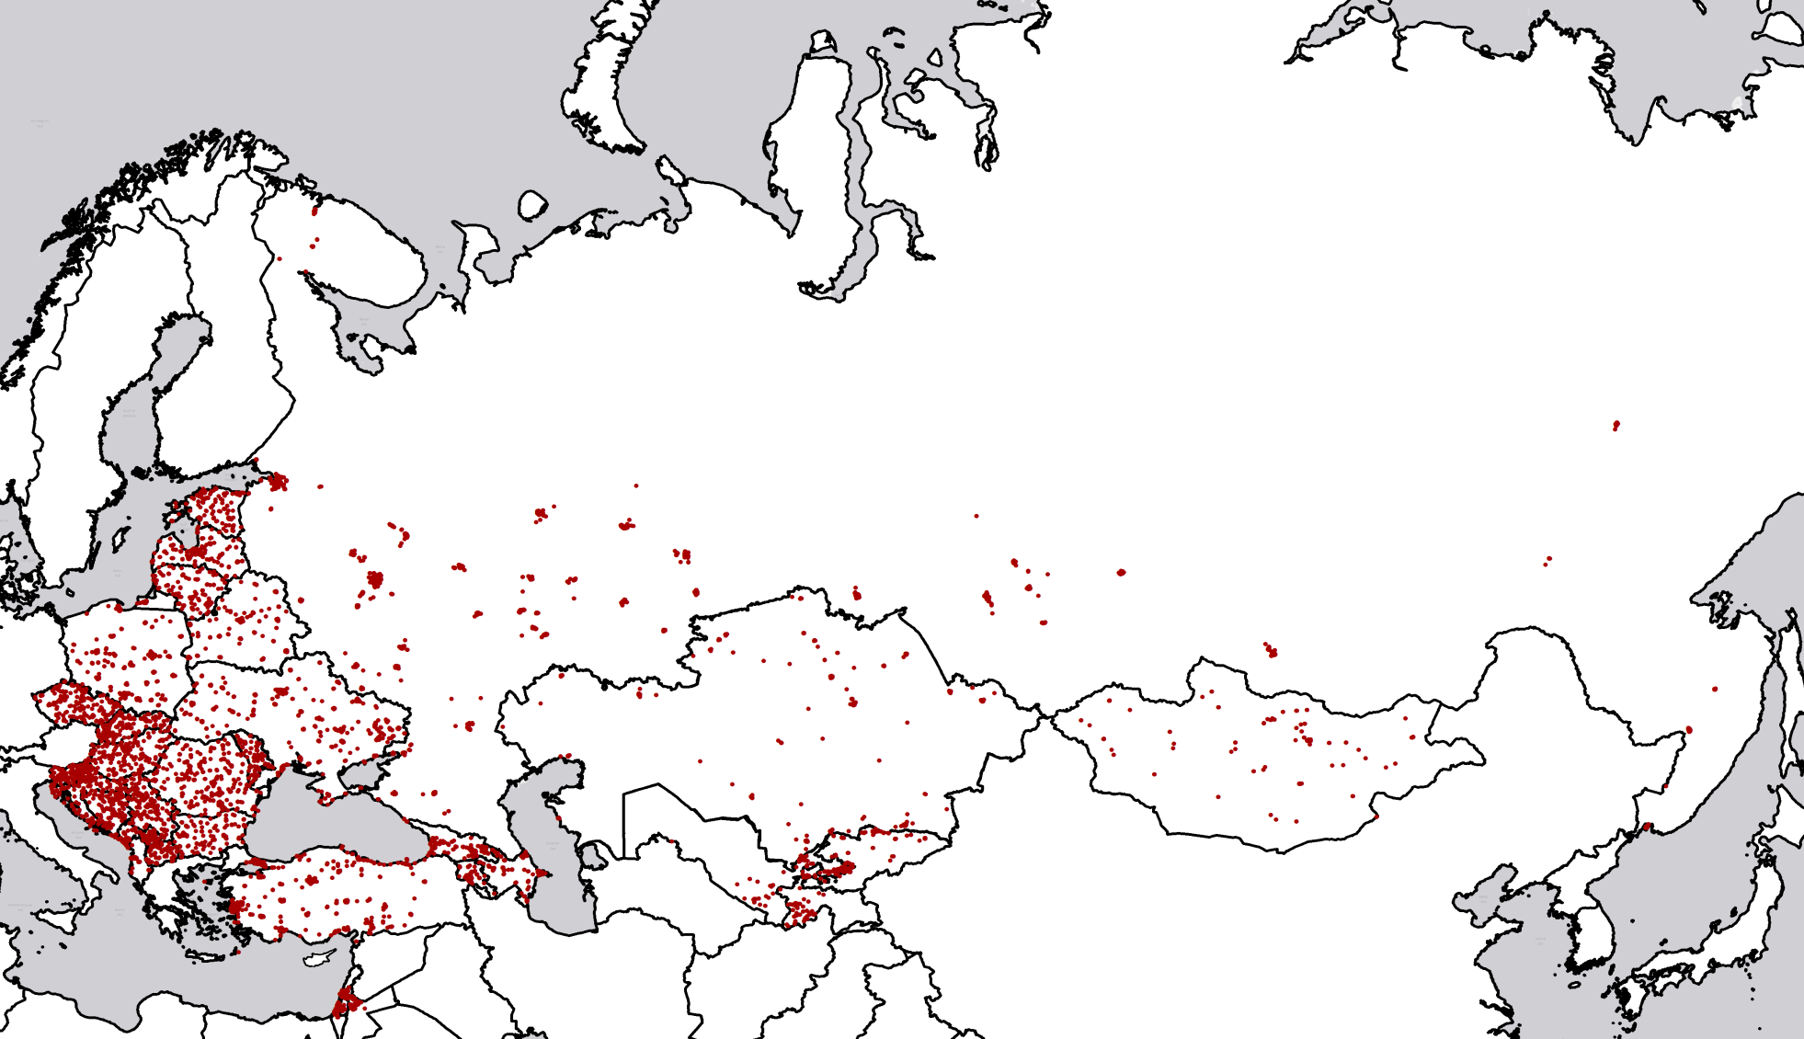
Taking the pulse on firm innovation
BEEPS V:
Around 16,000 firms in
30 countries and similar surveys in Jordan and Israel
4

Slide 5
BEEPS V: Special Focus on innovation
First BEEPS round to include a detailed module on innovation and management/organisation practices
Respondents asked if their firm introduced new or significantly improved products, processes, organisational arrangements or marketing methods in the past three years
Extensive “cleaning” needed to distinguish genuine innovation from non-innovation, and to apply the right classification

Slide 6
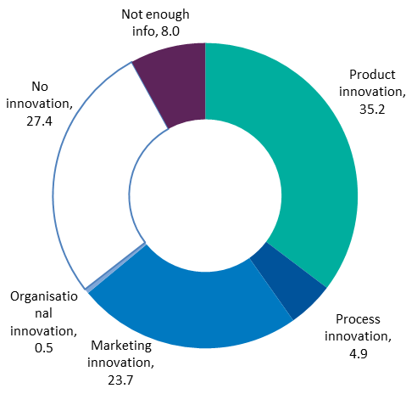
Descriptions of innovations analysed to achieve consistency
Product innovation, reclassified as:

Slide 7
Zooming in on a firm in transition
The many faces of innovation: focus on technology adoption
Innovation as a driver of improvements in firm productivity
What drives innovation?
Funding innovation
Policies for innovation

Slide 8

Innovation in Croatia: New products
Atlantic Multipower part of Atlantic Group
State-of-the-art production facility in Nova Gradiska
Multipower is one of the leading European producers of sports food and supplements
New services: protein and protein and carbohydrate bars
Selling through own sales and marketing representatives in Germany, UK, Italy and Spain and own distribution in SEE region

Slide 9

Innovation in Croatia: New production processes
ABS Sisak - part of Danieli Group steel-making division ABS Italy
Sisak steel mill restructuring and modernisation programme
New production processes: Innovative technology aimed at improving the environmental footprint of the steel works and minimising the production of scrap (Green Steel)
Transfer of knowledge from ABS R&D centre in Metz to ABS Sisak responsible for engineering and launching of new products
Selling through Danieli Group and directly to the clients in Central Europe

Slide 10

Innovation in Croatia: New services
Data Centre in Jastrebarsko, Croatia
Greenfield investment in data storage company
Highest industry standards: first Tier 3 carrier-neutral data centre in Croatia
New services: data centre, business continuity and disaster recovery
Clients – energy and postal services corporates, banks and other financial institutions.

Slide 11
Firms in the transition region focus on technology adoption, rather than bringing new products to the international market
Growth 1993-2010
% of firms with a new product
Source: BEEPS V

Slide 12
Zooming in on a firm in transition
The many faces of innovation: focus on technology adoption
Innovation as a driver of improvements in firm productivity
What drives innovation?
Funding innovation
Policies for innovation

Slide 13
In each country firms can innovate to improve their productivity

Slide 14
Productivity in Croatia relatively high, but further improvements needed
?

Slide 15
High pay-off to all types of innovation in all sectors…
Impact on labour productivity
Growth 1993-2010
Source: : BEEPS V, MENA ES

Slide 16
…and highest in low-tech industries…

Slide 17
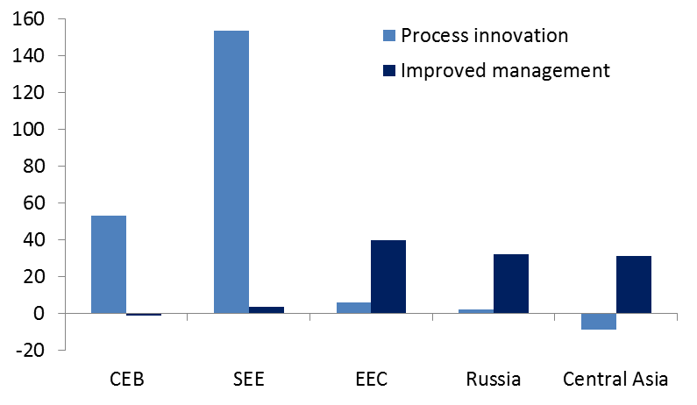
In less advanced countries the quality of management is key
Management needs to be improved before new processes can yield substantial productivity gains
Increase in productivity, %
Growth 1993-2010
Increase in productivity, %
Source: BEEPS V, MENA ES

Slide 18
Zooming in on a firm in transition
The many faces of innovation: focus on technology adoption
Innovation as a driver of improvements in firm productivity
What drives innovation?
Funding innovation
Policies for innovation

Slide 19
What determines innovation?
Internal factors
Firm characteristics (age, size, ownership)
Firm choices (to export, to hire skilled personnel)
External factors
Business environment
Firm choices are shaped by external factors
How difficult is it to export, to find skilled workers?

Slide 20
Innovative firms are more sensitive to the business environment
In particular: corruption, skills and access to finance
Greater constraint for innovators
Greater constraint for non-innovators
20

Slide 21
In Central Europe/Baltics, main obstacles for innovators are tax administration, finance and electricity…
Greater constraint for innovators
Greater constraint for non-innovators
21

Slide 22
…while in Croatia it is the informal sector that creates biggest problems for innovators
Greater constraint for innovators
Croatia
Greater constraint for non-innovators
22

Slide 23
Zooming in on a firm in transition
The many faces of innovation: focus on technology adoption
Innovation as a driver of improvements in firm productivity
What drives innovation?
Funding innovation
Policies for innovation

Slide 24
Can banks help firms to innovate?
No
  Intangible and firm-specific assets cannot be used as collateral
  Firms are hesitant to disclose sensitive information on innovative activity
  Banks are technologically conservative
Yes
  Banks specialise in building lending relationships with clients
  Innovation is more than just R&D
  In some countries, bank credit may be the only source of external finance

Slide 25
Yes, if they relieve credit constraints
There is regional variation in inter-bank competition and the presence of foreign banks…
Local credit constraints
…which determines whether firms have access to credit or not.
Firm innovation
Firms with access to credit introduce new products and processes to their markets.
Local banking market

Slide 26
Banks positively affect firms’ ability to innovate

Slide 27
Zooming in on a firm in transition
The many faces of innovation: focus on technology adoption
Innovation as a driver of improvements in firm productivity
What drives innovation?
Funding innovation
Policies for innovation

Slide 28
Embrace economic openness
Help firms export, enter global value chains through quality certifications, streamlined export procedures and VAT refunds
Armenia - Cisco, Microsoft partnerships, special events. ICT companies now get 44% of revenues from exports
Slovak Republic - special incentives for foreign firms, including SMEs, to come to less developed regions
Estonia – focus on international cooperation, foreign R&D investment grew by 15 per cent a year

Slide 29
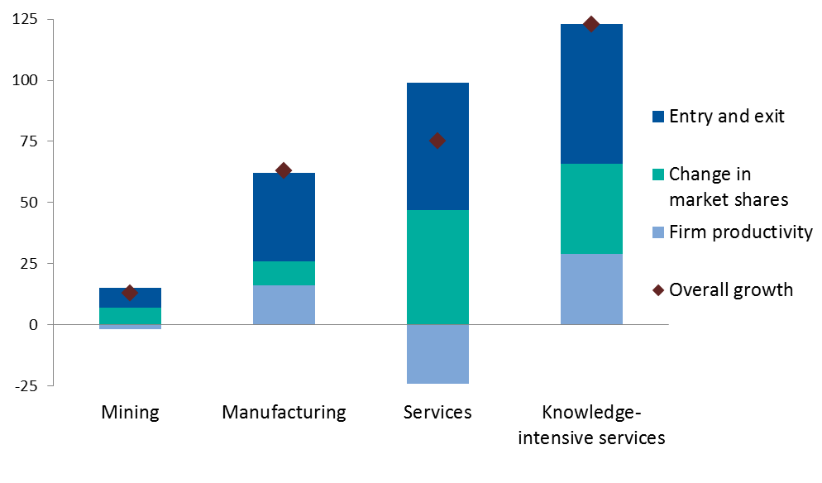
Lower barriers to entry of firms
WTO-related liberalisation of services in Ukraine led to improved firm productivity, largely through entry and exit
Higher productivity
Source: : Calculations based on Derzhkomstat data.

Slide 30
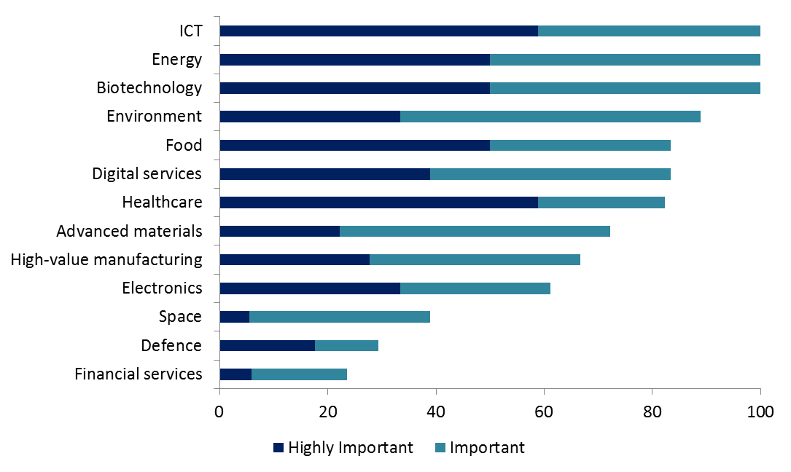
Focus on horizontal policies where governance weak
Innovation policies tend to focus on a few high-tech sectors…
% of countries viewing sector as priority…
Sources: EBRD Innovation Policy Questionnaire

Slide 31
TRANSITION
REPORT
2014
tr.ebrd.com
Go
online
now
tr.ebrd.com

